Slide 1

Flight Fare Prediction
Arshdeep Singh
GitHub Repo Link

Slide 2
Objective
The primary objective of this project is to develop a machine learning model that accurately predicts the fare of flight tickets. This model takes into account various factors such as the date of journey, location, destination, and other relevant parameters. By providing an accurate estimate of flight fares, the model aims to assist users in planning their travel more effectively and economically. Furthermore, this project seeks to provide real-time experience in implementing a machine learning model from scratch, including stages such as data gathering, preprocessing, modeling, and deployment. Ultimately, the goal is to create a user-friendly interface that delivers these predictions in an accessible and understandable format.

Slide 3
Benefits
Cost-Efficiency: By predicting flight fares, users can plan their travel more economically. They can choose the most cost-effective options and save money on their travel expenses.
Time-Saving: With the help of this project, users no longer need to manually check and compare flight fares from different airlines. The model provides an instant prediction, saving users a significant amount of time.
Informed Decision-Making: The project helps users make informed decisions about their travel plans. By knowing the predicted fare, they can decide the best time to book a flight.
Real-Time Experience: This project provides real-time experience in implementing a machine learning model from scratch, including stages such as data gathering, preprocessing, modeling, and deployment. This can be particularly beneficial for those interested in learning and practicing data science and machine learning concepts.
User-Friendly Interface: The project includes a user-friendly interface that delivers predictions in an accessible and understandable format.

Slide 4
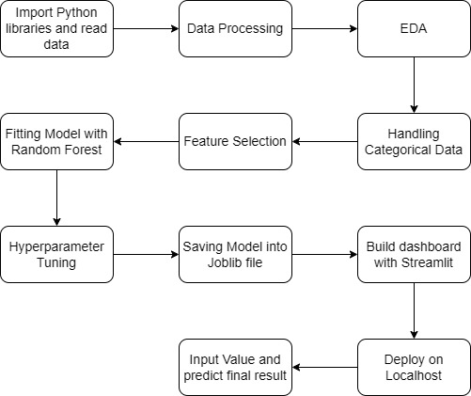
Architecture

Slide 5
Data Transformation
Checking Data Types: The first step in preprocessing was to check the data types of the columns. It was found that only the price column was of type integer.
Handling Null Values: The dataset was checked for null values. Any rows containing null values were dropped to ensure the integrity of the data.
Date Time Conversion: All necessary columns were converted into the date time format. This is important for handling time series data, and it allows the model to understand and use this information effectively.
One-Hot Encoding: One-hot encoding was performed on the required columns. This is a process of converting categorical data variables so they can be provided to machine learning algorithms to improve predictions.
Data Scaling: Scaling was performed on the required data. This process is used to standardize the range of features of data. Since the range of raw data may vary widely, this could negatively impact the model’s ability to learn from the data. Scaling solves this problem.

Slide 6
Model Training
Data Preparation: The preprocessed data, which has been cleaned, encoded, and scaled, is ready for model training.
Model Selection: Various machine learning algorithms were tested to find the most suitable one for this dataset. Algorithms such as Random Forest Regression, XGBoost, and others were considered.
Model Training: The selected model, Random Forest Regression, was trained on the preprocessed data. This involves feeding the data into the model so it can learn the underlying patterns and relationships.
Hyperparameter Tuning: To increase the model’s accuracy, hyperparameter tuning was performed. This involves adjusting the parameters of the model to find the combination that produces the best results.
Model Evaluation: The performance of the model was evaluated using appropriate metrics. This helps to understand how well the model is performing and whether it’s ready for deployment.
Insights from Data Visualization: Insights drawn from data visualization were used in the modeling process. Although the data was randomly spread, these insights helped in selecting the right model and improving its performance.

Slide 7
Machine Learning Algorithms
LightGBM Regressor
ExtraTree Regressor
XGBoost Regressor
RandomForest Regressor
Model Selection
After feature selection, I optimize the algorithms and tested each algorithms using various metrics, I have checked Cross Validation Scores. At the end Random Forest Regressor is giving the best out with Training and Testing score are approximately equal.

Slide 8
Prediction
The testing files are shared in the batches and we perform the same validation operations, data transformation and data insertion on them.
I perform data pre-processing techniques on it.
Random Forest model created during training is loaded.
User input are transformed into data frame and then scaled.
Ticket Price is predicted using the transformed data.

Slide 9
Q&A
What’s the source of data?
The data for training is provided from Kaggle.
What was the type of data?
The data was the combination of numerical and Categorical values.
What’s the complete flow you followed in this Project?
Refer slide 5th for better Understanding.

Slide 10
Q&A
How logs are managed?
Different logs as per the steps that we follow in validation and modeling like data transformation, model training log and prediction log etc.
What techniques were you using for data pre-processing?
Removing unwanted attributes.
Visualizing relation of independent variables with each other and output variables.
Checking and changing Distribution of continuous values.
Removing outliers.
Cleaning data and imputing if null values are present.
Converting categorical data into numeric values.
Scaling the data.

Slide 11

Q&A
How training was done or what models were used?
The scaling was performed over training and validation data.
Algorithms like LightGBM, XGBoost, ExtraTree and RandomForest were used based on the recall final model
What are the different stages of deployment?
When the model is ready first test in local environment and then deployed to Streamlit cloud.

